Slide 1

50.039 Theory and Practice of Deep Learning W11-S3 More on Reinforcement Learning
Matthieu De Mari

Slide 2
Conclusion
What are actor-critic learning methods? And which problems do these approaches address?
What are more advanced problems in RL?
Markov states
Partially observable environment
SARSA
Non-stationary problems

Slide 3
A quick word on actor-critic methods (more advanced stuff, out of scope)
In Deep Q-learning, we realized that most RL problems cannot have their Q functions computed easily.
We then replaced the Q function with a Deep Neural Network to approximate this function.

Slide 4
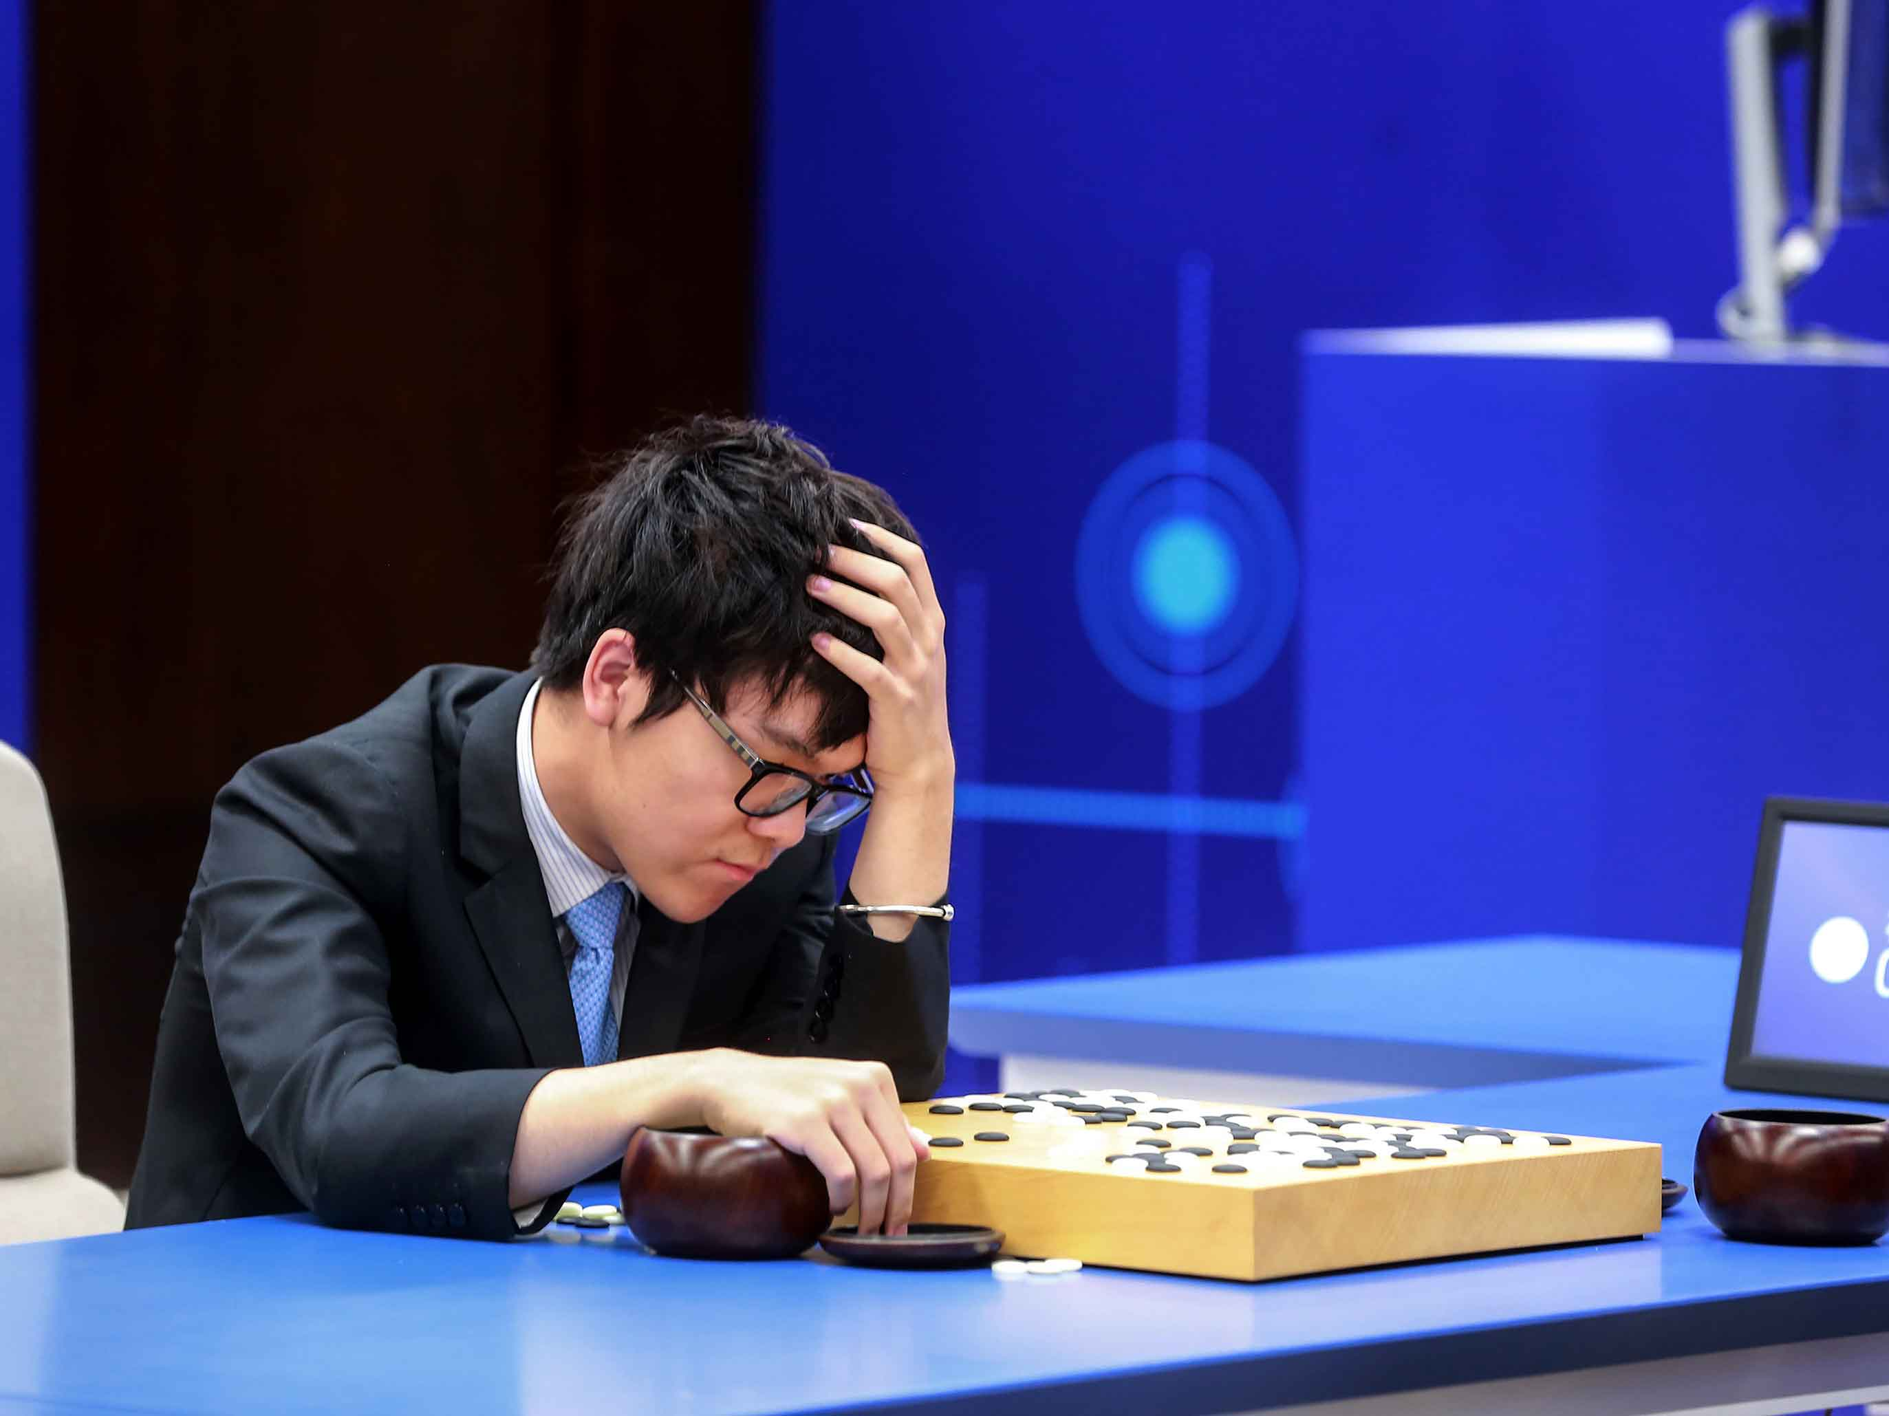
A quick word on actor-critic methods (more advanced stuff, out of scope)
In Deep Q-learning, we realized that most RL problems cannot have their Q functions computed easily.
We then replaced the Q function with a Deep Neural Network to approximate this function.
Additional suggestion: Can the reward function always be computed?

Slide 5
A quick word on actor-critic methods (more advanced stuff, out of scope)
In Deep Q-learning, we realized that most RL problems cannot have their Q functions computed easily.
We then replaced the Q function with a Deep Neural Network to approximate this function.
Additional suggestion: Can the reward function always be computed?
→ Replace more elements of the RL system with Deep Neural Networks.

Slide 6
A quick word on actor-critic methods (more advanced stuff, out of scope)
Definition (actor-critic):
Actor-critic algorithms consist of two components.
Actor: a DNN, whose purpose is to produce actions in response to given states, i.e. a policy. Can be trained as in Deep Q-learning.

Slide 7
A quick word on actor-critic methods (more advanced stuff, out of scope)
Definition (actor-critic):
Actor-critic algorithms consist of two components.
Actor: a DNN, whose purpose is to produce actions in response to given states, i.e. a policy. Can be trained as in Deep Q-learning.
Critic: a DNN, whose purpose is to evaluate the quality of the selected actions and suggesting directions for improvement, by defining a reward function or a Q function.

Slide 8
A quick word on actor-critic methods (more advanced stuff, out of scope)
Definition (actor-critic):
Actor-critic algorithms consist of two components.
Actor: a DNN, whose purpose is to produce actions in response to given states, i.e. a policy. Can be trained as in Deep Q-learning.
Critic: a DNN, whose purpose is to evaluate the quality of the selected actions and suggesting directions for improvement, by defining a reward function or a Q function.
In a sense, similar to the Generator-Critic pair of the Wasserstein GANs!
Generator: produce fake images
Critic: evaluate said images

Slide 9
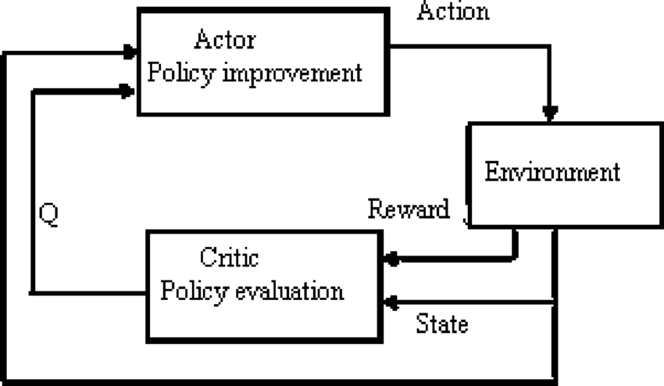
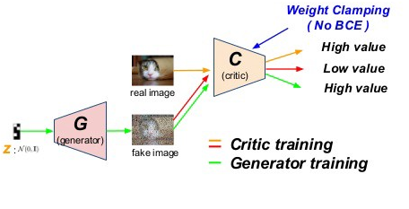
From Deep Q learning to actor-critic

Slide 10
RL with Human Feedback
Definition (Reinforcement Learning with Human Feedback):
Reinforcement Learning with Human Feedback (or RLHF) is a method in which an AI model (pre-trained or not), is typically represented as a reinforcement learning agent, and is fine-tuned based on feedback provided by humans to improve its performance on a specific task.
This approach combines the strengths of reinforcement learning algorithms, which learn through trial and error, with the expertise and judgment of human evaluators.

Slide 11
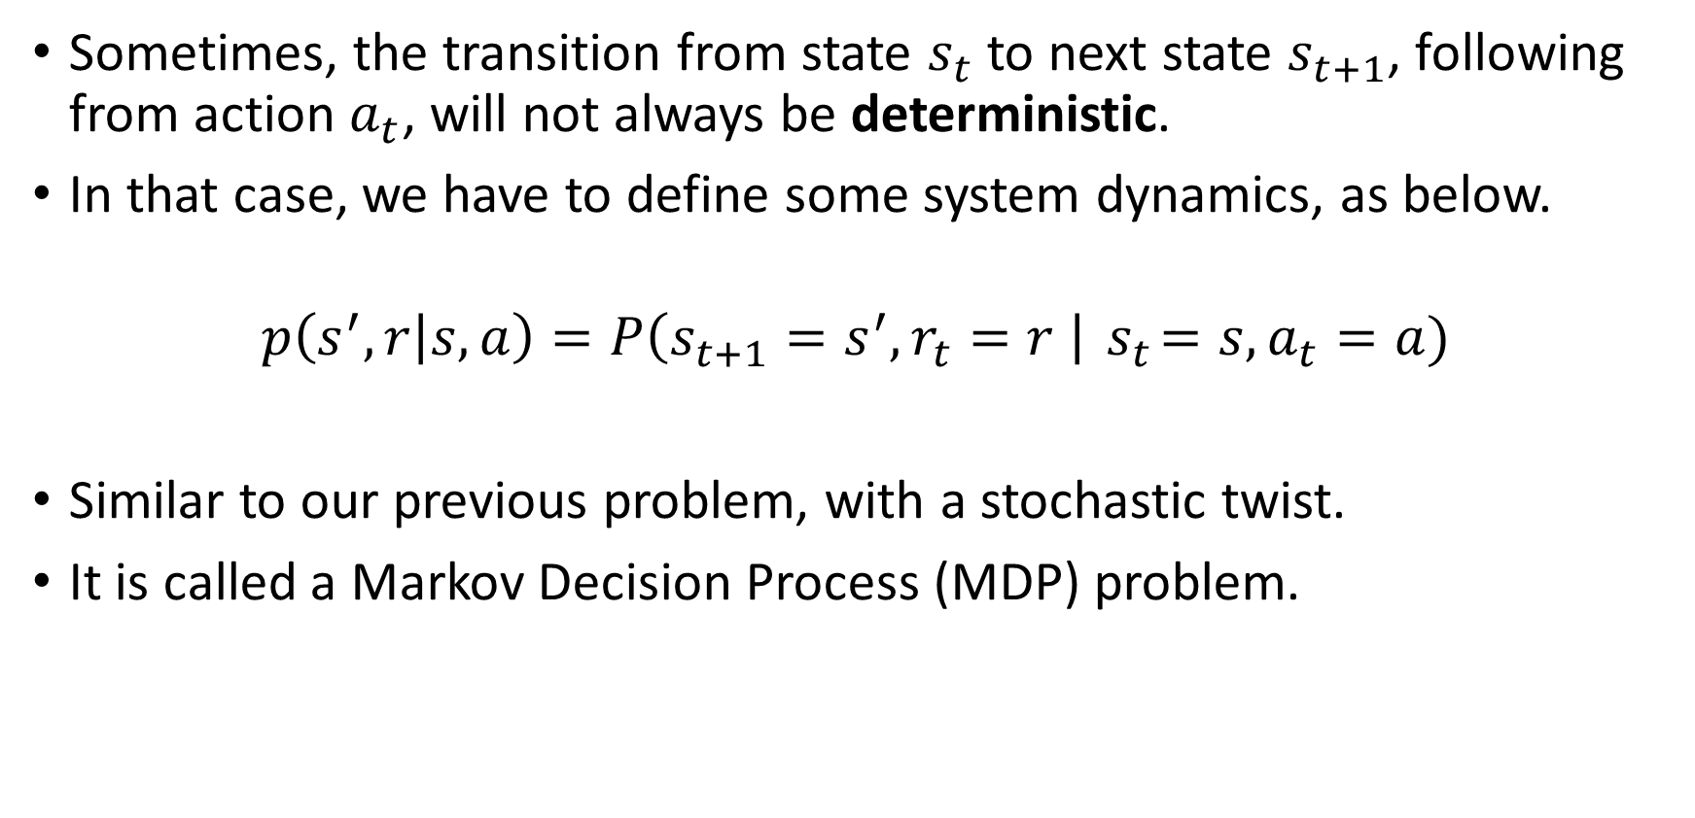
Markov Decision Processes (more advanced stuff, out of scope)
Sometimes, the transition from state $s_{t}$ to next state $s_{t+1}$, following from action $a_{t}$, will not always be deterministic.
In that case, we have to define some system dynamics, as below.
$$p\left(s^{′},r | s,a\right)=P\left(s_{t+1}=s^{′}, r_{t}=r \right|{ s}_{t}=s, a_{t}=a)$$
Similar to our previous problem, with a stochastic twist.
It is called a Markov Decision Process (MDP) problem.

Slide 12
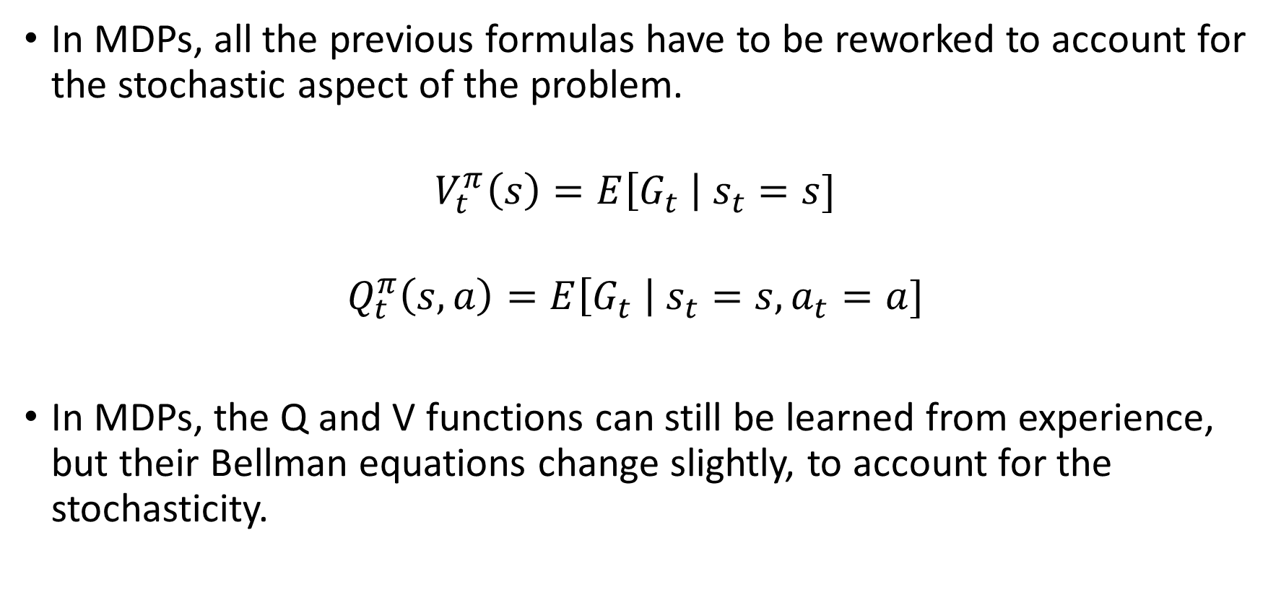
Markov Decision Processes (more advanced stuff, out of scope)
In MDPs, all the previous formulas have to be reworked to account for the stochastic aspect of the problem.
$$V_{t}^{π}\left(s\right)=E\left[G_{t} \right| s_{t}=s]$$
$$Q_{t}^{π}\left(s,a\right)=E\left[G_{t} \right| s_{t}=s, a_{t}=a]$$
In MDPs, the Q and V functions can still be learned from experience, but their Bellman equations change slightly, to account for the stochasticity.

Slide 13
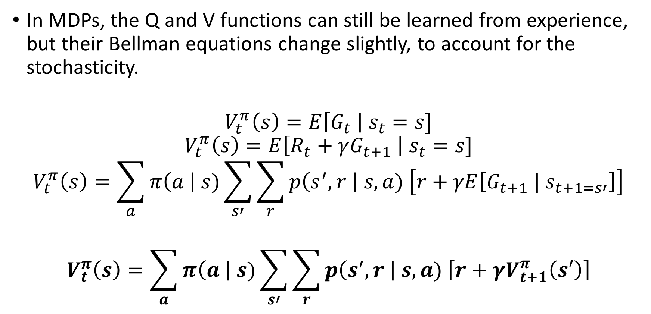
Markov Decision Processes (more advanced stuff, out of scope)
In MDPs, the Q and V functions can still be learned from experience, but their Bellman equations change slightly, to account for the stochasticity.
$$V_{t}^{π}\left(s\right)=E\left[G_{t} \right| s_{t}=s]$$
$$V_{t}^{π}\left(s\right)=E\left[R_{t}+γG_{t+1} \right| s_{t}=s]$$
$$V_{t}^{π}\left(s\right)=\sum_{a}{π\left(a \right| s)\sum_{s′}{\sum_{r}{p\left(s^{′}, r \right| s,a) \left[r+γE\left[G_{t+1} | s_{t+1=s′}\right]\right]}}}$$
$$V_{t}^{π}\left(s\right)=\sum_{a}{π\left(a \right| s)\sum_{s′}{\sum_{r}{p\left(s^{′}, r \right| s,a) \left[r+γV_{t+1}^{π}\left(s′\right)\right]}}}$$

Slide 14
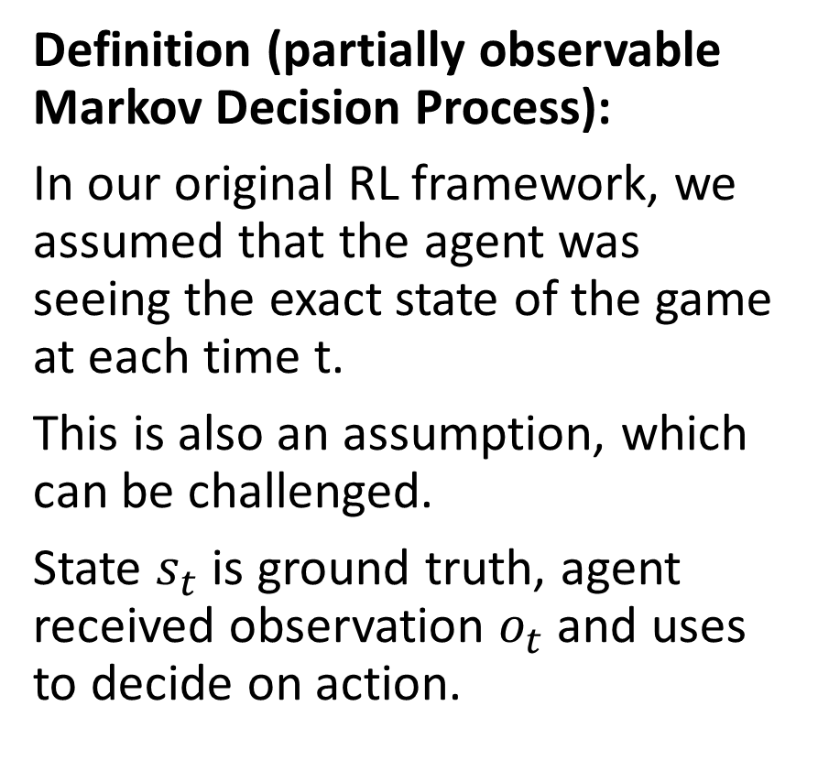
Partially observable MDP (more advanced stuff, out of scope)
Definition (partially observable Markov Decision Process):
In our original RL framework, we assumed that the agent was seeing the exact state of the game at each time t.
This is also an assumption, which can be challenged.
State $s_{t}$ is ground truth, agent received observation $o_{t}$ and uses to decide on action.
State
Take action based on observation
Reward is given for taking action in said state
Environment changes and a new state is produced
Observation is made by agent

Slide 15
Partially observable MDP (more advanced stuff, out of scope)
Definition (partially observable Markov Decision Process):
The agent then decides on an observation made of the actual (partially hidden) state.
This is called a partially observable Markov Decision Process.
Agent will have to learn to observe on top of acting properly (e.g. card game, with opponent hiding his/her hand).
State
Take action based on observation
Reward is given for taking action in said state
Environment changes and a new state is produced
Observation is made by agent

Slide 16
State-Action-Reward-State-Action or SARSA (more advanced stuff, out of scope)
In many problems, e.g. Go, the new state seen by a given player is not the result of the action of the said player.
Instead, another player has to act first, before a new state is produced.

Slide 17
State-Action-Reward-State-Action or SARSA (more advanced stuff, out of scope)
In many problems, e.g. Go, the new state seen by a given player is not the result of the action of the said player.
Instead, another player has to act first, before a new state is produced.
This adds steps to the cycle, which becomes (state, action, reward, state_P2, action_P2).
Board state
P1 will take action based on state
Reward is given to P1 for taking action in said state
Environment changes and a new state is produced for P2
P2 will take action based on state
A new state will be produced for P1

Slide 18
State-Action-Reward-State-Action or SARSA (more advanced stuff, out of scope)
This is called a State-Action-Reward-State-Action (SARSA) type of problem.
In that case the agent has to learn how to play, but also has to learn how another player might respond to its actions.
RL meets game theory!
Board state
P1 will take action based on state
Reward is given to P1 for taking action in said state
Environment changes and a new state is produced for P2
P2 will take action based on state
A new state will be produced for P1

Slide 19
State-Action-Reward-State-Action or SARSA (more advanced stuff, out of scope)
This is called a State-Action-Reward-State-Action (SARSA) type of problem.
In that case the agent has to learn how to play, but also has to learn how another player might respond to its actions.
→ Train two AIs at the same time (one for black, one for whites)? Make them play against each other and train together like generator-critic in WGANs?
Board state
P1 will take action based on state
Reward is given to P1 for taking action in said state
Environment changes and a new state is produced for P2
P2 will take action based on state
A new state will be produced for P1

Slide 20
Conclusion
What are actor-critic learning methods? And which problems do these approaches address?
What are more advanced problems in RL?
Markov states
Partially observable environment
SARSA
Non-stationary problems

